Slide 1
Tools & Python
Nicholas Mattei, Tulane University
CMPS3660 – Introduction to Data Science – Fall 2019
https://rebrand.ly/TUDataScience
Many Thanks
Slides based off Introduction to Data Science from John P. Dickerson - https://cmsc320.github.io/
Some examples taken from Data Science by John D. Kelleher and Brendan Tierney, MIT Press.

Slide 2
Announcements
Dr. Mattei’s Office Hours will be:
Tuesday 1400 – 1500 (going possibly later)
Thursday 1600 – 1700 (going possibly later)
Arie is here!
We now have 34 People in the course.
If you are not formally enrolled and want to be come see me after class.
Both Project0 and Questions1 are posted.
https://github.com/TulaneIntroDataScience/fall2019/tree/master/project0
Quick overview on how to notebook…
Please complete Project0 before class on 9/5 – want to do in class lab work that day!

Slide 3
The Data LifeCycle
Today
Data Collection
Data Processing
Exploratory Analysis
&
Data Visualization
Analysis, Hypothesis Testing,
& ML
Insight
&
Policy Decision

Slide 4
But first, snakes!
Python is an interpreted, dynamically-typed, high-level, garbage-collected, object-oriented-functional-imperative, and widely used scripting language.
Interpreted: instructions executed without being compiled into (virtual) machine instructions*
Dynamically-typed: verifies type safety at runtime
High-level: abstracted away from the raw metal and kernel
Garbage-collected: memory management is automated
OOFI: you can do bits of OO, F, and I programming
OO = Object Oriented (you can make objects)
F = Functional (everything is a function, stateless, like LISP)
I = Imperative (i.e., procedural)
Not the point of this class!
Python is fast (developer time), intuitive, and used in industry!
*you can compile Python source, but it’s not required

Slide 5
The Zen of Python
Beautiful is better than ugly.
Explicit is better than implicit.
Simple is better than complex.
Complex is better than complicated.
Flat is better than nested.
Sparse is better than dense.
Readability counts.
Special cases aren't special enough to break the rules …
… although practicality beats purity.
Errors should never pass silently …
… unless explicitly silenced.
Thanks: SDSMT ACM/LUG

Slide 6
Literate Programming
Literate code contains in one document:
the source code;
text explanation of the code; and
the end result of running the code.
Basic idea: present code in the order that logic and flow of human thoughts demand, not the machine-needed ordering
Necessary for data science!
Many choices made need textual explanation, ditto results.
Stuff you’ll be using in Project 0 (and beyond)!

Slide 7
10-Minute Python primer
Define a function:
Python is whitespace-delimited
Define a function that returns a tuple:
def my_func(x, y):
if x > y:
return x
else:
return y
def my_func(x, y):
return (x-1, y+2)
(a, b) = my_func(1, 2)
a = 0; b = 4

Slide 8
Useful Build-In Functions
len: returns the number of items of an enumerable object
range: returns an iterable object
enumerate: returns iterable tuple (index, element) of a list
https://docs.python.org/3/library/functions.html
len( [‘c’, ‘m’, ‘s’, ‘c’, 3, 2, 0] )
7
list( range(10) )
[0, 1, 2, 3, 4, 5, 6, 7, 8, 9]
enumerate( [“311”, “320”, “330”] )
[(0, “311”), (1, “320”), (2, “330”)]
Notes:
do demo

Slide 9
Useful Built In Fucntions: Map and Filter
Note!
There is a problem here for Python3!
map: apply a function to a sequence or iterable
filter: returns a list of elements for which a predicate is true
We’ll go over in much greater depth with pandas/numpy as the syntax is a little different.
arr = [1, 2, 3, 4, 5]
map(lambda x: x**2, arr)
[1, 4, 9, 16, 25]
arr = [1, 2, 3, 4, 5, 6, 7]
filter(lambda x: x % 2 == 0, arr)
[2, 4, 6]

Slide 10
Pythonic Programming
Basic iteration over an array in Java:
Direct translation into Python:
A more “Pythonic” way of iterating:
int[] arr = new int[10];
for(int idx=0; idx<arr.length; ++idx) {
System.out.println( arr[idx] );
}
idx = 0
while idx < len(arr):
print( arr[idx] ); idx += 1
for element in arr:
print( element )

Slide 11
List Comprehensions
Construct sets like a mathematician!
P = { 1, 2, 4, 8, 16, …, 2¹⁶ }
E = { x | x in ℕ and x is odd and x < 1000 }
Construct lists like a mathematician who codes!
Very similar to map, but:
You’ll see these way more than map in the wild
Many people consider map/filter not “pythonic”
They can perform differently (map is “lazier”)
P = [ 2**x for x in range(17) ]
E = [ x for x in range(1000) if x % 2 != 0 ]

Slide 12
Python 2 vs 3
Python 3 is intentionally backwards incompatible
(But not that incompatible)
Biggest changes that matter for us:
print “statement” → print(“function”)
1/2 = 0 → 1/2 = 0.5 and 1//2 = 0
ASCII str default → default Unicode
Namespace ambiguity fixed:
i = 1
[i for i in range(5)]
print(i) # ????????
Prints “4” in Python 2 and “1” in Python 3 (narrow scope)
Notes:
Prints “4” in Python 2 and “1” (i.e., unchanged because the list comprehension scope is dead) in Python 3.

Slide 13
To Any Curmudgeons
If you’re going to use Python 2 anyway, use the _future_ module:
Python 3 introduces features that will throw runtime errors in Python 2 (e.g., with statements)
_future_ module incrementally brings 3 functionality into 2
https://docs.python.org/2/library/__future__.html
from _future_ import division
from _future_ import print_function
from _future_ import please_just_use_python_3
In CMPS 3660 this is wrong.
If your code does not run in Python 3, it is wrong.
I’m in charge!

Slide 14
Python v. R (For Data Scientists)
There is no right answer here!
Python is a “full” programming language – easier to integrate with systems in the field
R has a more mature set of pure stats libraries …
… but Python is catching up quickly …
… and is already ahead specifically for ML.
You will see Python more in the tech industry.

Slide 15
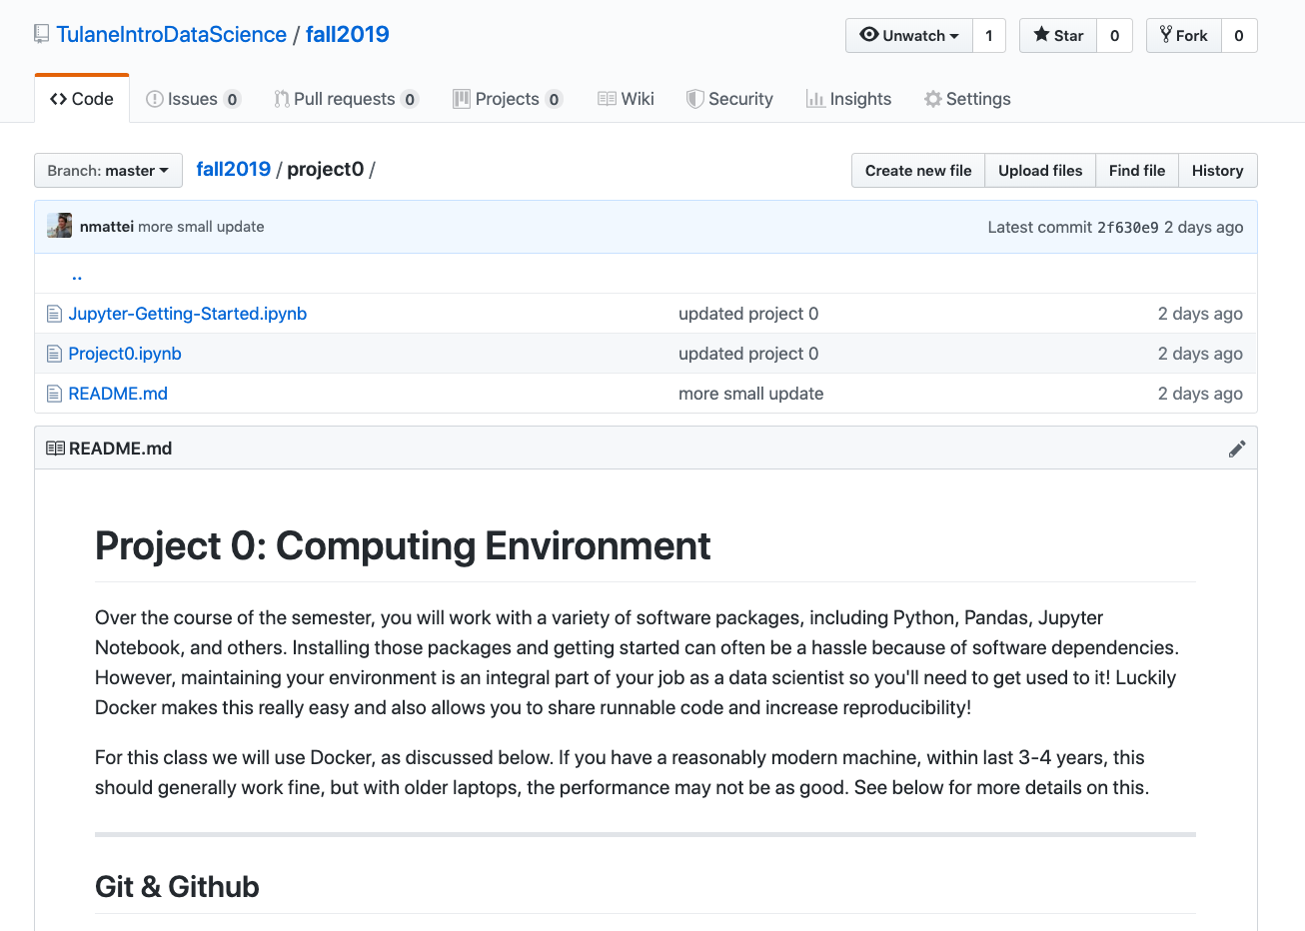
Extra resources
Plenty of tutorials on the web:
https://www.learnpython.org/
Go look at the Notebook that we made for class today!
Link TBD.
Work through Project 0, which will take you through some baby steps with Python and Docker.
https://github.com/TulaneIntroDataScience/fall2019/tree/master/project0

